Slide 1

ROUTING IN WIRELESS SENSOR NETWORK

Slide 2
CONTENTS
Introduction
Routing challenges in WSN
Flat Routing
Hierarchical Routing
Location-based Routing
Routing Protocols Based on Protocol Operation
Some Other Routing protocols
Conclusion
References

Slide 3
Introduction
Routing is a process of selecting paths in a network along which to send data traffic.
First, it is not possible to build a global addressing scheme for a large number of sensor nodes. Thus, traditional IP-based protocols may not be applied to WSNs. In WSNs, sometimes getting the data is more important than knowing the IDs of which nodes sent the data.
Second, in contrast to typical communication networks, almost all applications of sensor networks require the flow of sensed data from multiple sources to a particular base station.

Slide 4
Introduction
Routing protocols in WSNs Differ depending on the application and network architecture
Sensor nodes are tightly constrained in terms of energy, processing, and storage capacities. Thus, they require carefully resource management.
Position awareness of sensor nodes is important since data collection is normally based on the location.
Data collected by many sensors in WSNs is typically based on common phenomena, hence there is a high probability that this data has some redundancy

Slide 5
Routing challenges and design issues
Node deployment
Energy consumption without losing accuracy
Data reporting method
Node/link heterogeneity
Scalability
Data aggregation
Quality of service

Slide 6
Routing challenges and design issues
Node deployment
Manual deployment
Sensors are manually deployed
Data is routed through predetermined path
Random deployment
Optimal clustering is necessary to allow connectivity & energy-efficiency
Multi-hop routing

Slide 7
Routing challenges and design issues
Data reporting method
Application-specific:
Time-driven: Periodic monitoring
Event-driven: Respond to sudden changes
Query-driven: Respond to queries
Hybrid (combination of delivery models)

Slide 8
Routing challenges and design issues
Node/link heterogeneity
Depending on the application, a sensor node can have a different role or capability such as relaying, sensing and aggregation
Three functionalities at the same time on a node might quickly drain the energy of that node.
Combining these capabilities on one node raises a challenge for routing protocols.
For example, hierarchical protocols designate a cluster head node

Slide 9
Routing challenges and design issues
Fault tolerance
The failure of sensor nodes should not affect the overall task of the sensor network
Connectivity
High density High connectivity
Some sensors may die after consuming their battery power
Connectivity depends on possibly random deployment

Slide 10
Routing challenges and design issues
Network Dynamics
Routing messages from or to moving nodes is more challenging since route and topology stability become important issues
Moreover, the phenomenon can be mobile (e.g., a target detection/ tracking application).

Slide 11
Routing challenges and design issues
Coverage
An individual sensor’s view is limited
Area coverage is an important design factor
Data aggregation Since sensor nodes may generate significant redundant data, similar packets from multiple nodes can be aggregated to reduce the number of transmissions.
Data aggregation is the combination of data from different sources according to a certain aggregation function.
Quality of Service
Bounded delay
Energy efficiency for longer network lifetime

Slide 12
Routing Protocols in WSNs: A taxonomy

Slide 13
On the basis of path establishment
Proactive protocols :compute all the routes before they are really needed and then store these routes in a routing table in each node. When a route changes, the change has to be propagated throughout the network. Since a WSN could consist of thousands of nodes, the routing table that each node would have to keep could be huge and therefore proactive protocols are not suited to WSNs.
Reactive protocols: compute routes only when they are needed.
Hybrid protocols: use a combination of these two ideas.

Slide 14
Routing protocol survey
Traditional technique
Flooding
Gossiping
Current routing technique
Flat-routing
Hierarchical-routing
Location-based routing

Slide 15
Flooding(1/4)
Flooding is the classic approach for dissemination without the need for any routing algorithms and topology maintenance
Source node sends data to all neighbors
Receiving node stores and sends data to all its neighbours
Disseminate data quickly
Drawbacks:
Implosion
Overlap
Resource blindness

Slide 16
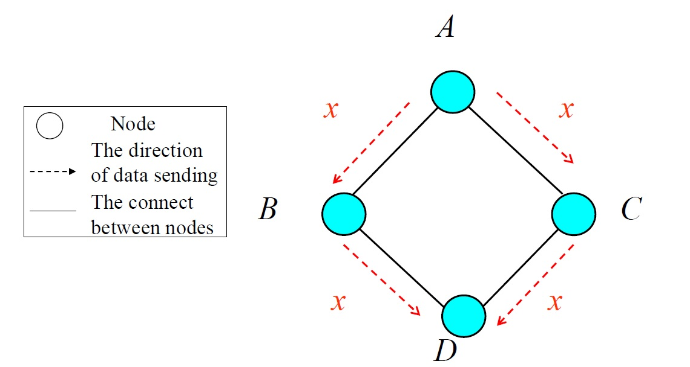
Implosion(2/4)

Slide 17
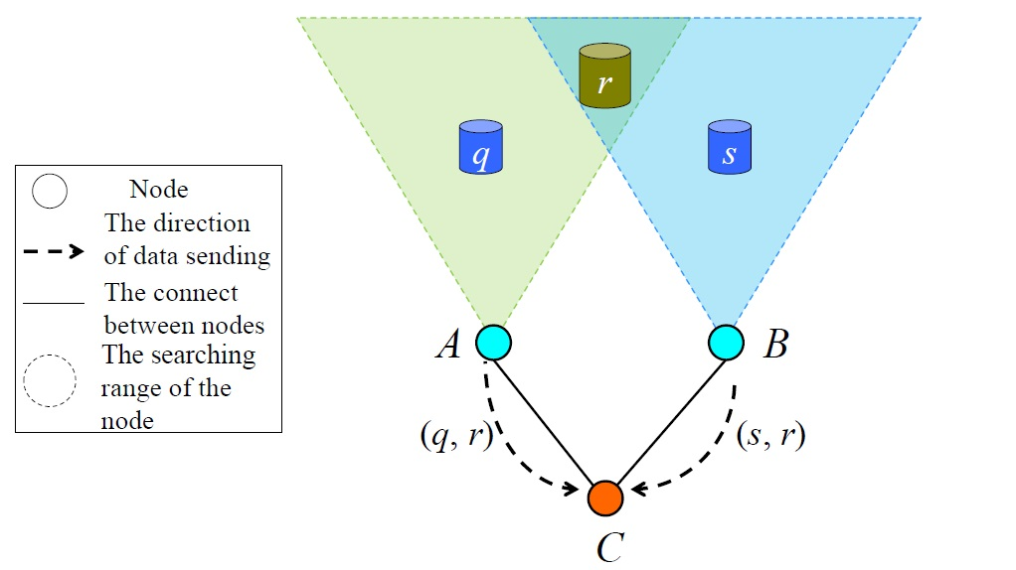
Overlap(3/4)

Slide 18
Resource blindness(4/4)
In flooding, nodes do not modify their activities based on the amount of energy available to them.
A network of embedded sensors can be resource-aware and adapt its communication and computation to the state of its energy resource.

Slide 19
Gossiping
A slightly enhanced version of flooding where the receiving node sends the packet to a randomly selected neighbor which picks another neighbor to forward the packet to and so on.
Advantage: avoid the implosion
Drawback: Transmission delay

Slide 20
Flat-routing (Data centric )
Each node plays the same role (Each node needs to know only its neighbours)
Data-centric routing: In data-centric routing, the sink sends queries to certain regions and waits for data from the sensors located in the selected regions.
Saves energy through data negotiation and elimination of redundant data
Protocols:
SPIN (Sensor Protocols for Information via Negotiation)
Directed diffusion
Rumour routing

Slide 21
Sensor protocols for information via negotiation (SPIN)
Features
Negotiation
Before transmitting data, nodes negotiate with each other to overcome implosion and overlap.
Only useful information will be transferred
Observed data must be described using a meta-data
Resource adaptation
Each sensor node has resource manager monitoring their own energy resources may reduce certain activities when energy is low to extend the operating lifetime of the system.
SPIN Message
ADV – new data advertisement
REQ – request for ADV data
DATA – actual data message Contain actual sensor data with a meta-data header
ADV, REQ messages contain only meta-data

Slide 22
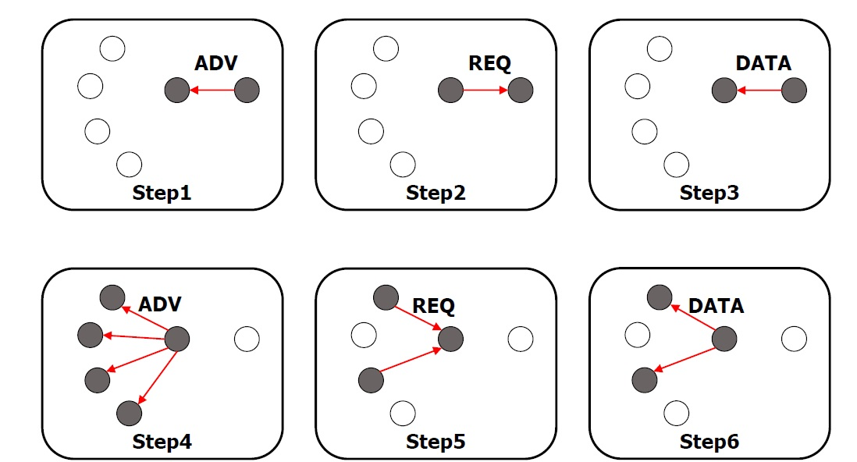
Sensor protocols for information via negotiation (SPIN)
Operation process

Slide 23
Sensor protocols for information via negotiation (SPIN)
Resource adaptive algorithm
When energy is plentiful
Communicate using the 3-stage handshake protocol
When energy is approaching a low-energy threshold
If a node receives ADV, it does not send out REQ
Energy is reserved to sensing the event
Advantage
Each node only needs to know its one-hop neighbors
Significantly reduce energy consumption compared to flooding
Drawback
If the node interested in the data are far from the source, data will not be delivered
Large overhead
Data broadcasting
Cannot guarantee delivery of data.

Slide 24
Directed Diffusion (DD)
Feature
Data-centric routing protocol
A path is established between sink node and source node
Localized interactions
The propagation and aggregation procedures are all based on local information.
Four elements
Interest
A task description which is named by a list of attribute-value pairs that describe a task
Gradient
Path direction, data transmission rate
Data message
Reinforcement
To select a single path from multiple paths

Slide 25
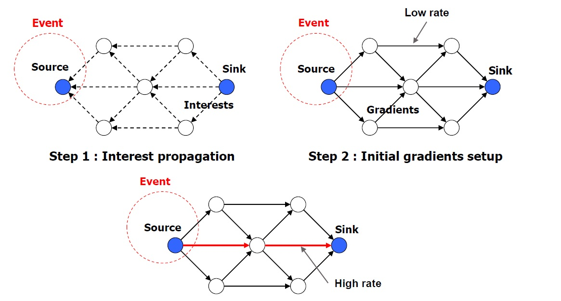
Directed Diffusion (DD)
Basic scheme

Slide 26
Directed Diffusion (DD)
Advantage
Small delay
Always transmit the data through shortest path
Robust to failed path
Drawback
Imbalance of node lifetime
The energy of node on shortest path is drained faster than another
Time synchronization technique
To implement data aggregation
Matching data to queries might require some extra overhead

Slide 27
Rumour Routing
Variation of directed diffusion
Doesn’t flood interests (or queries)
Flood events when the number of events is small but the number of queries large
Route the query to the nodes that have observed a particular event
Long-lived packets, called agents(Set up path by random walk, Aggregate paths), flood events through the network
When a node detects an event, it adds the event to its events table, and generates an agent.
Agents travel the network to propagate info about local events.
An agent is associated with TTL

Slide 28
Rumour Routing
Basic scheme
Each node maintain
A lists of neighbours
An event table
When a node detects an event
Generates an agent
Lets it travel on a random path
The visited node form a gradient to the event
When a sink needs an event
Transmit a query
A node knowing the route to a corresponding event can respond by looking up its events table
When a node receives query
It checks its table and returns source to destination path.

Slide 29
Rumour Routing
No need for query flooding
Only one path between the source and sink.
Rumor routing works well only when the number of events is small.
Cost of maintaining a large number of agents and large event tables will be prohibitive.

Slide 30
Hierarchical-routing
LEACH (Low Energy Adaptive Clustering Hierarchy)
PEGASIS (Power-Efficient Gathering in Sensor Information Systems)
TEEN(APTEEN) (Threshold-Sensitive Energy Efficient Protocols)

Slide 31
LEACH (Low Energy Clustering Hierarchy)
Cluster-based protocol
Each node randomly decides to become a cluster heads (CH)
CH chooses the code to be used in its cluster
CDMA between clusters
CH broadcasts ADV and each node decides, which cluster it belongs to, based on
the received signal strength of ADV.
Nodes can sleep when its not their turn to emit
CH compresses data received from the nodes in the cluster and sends the aggregated data to Base Station.
CH is rotated randomly
Cluster head
Base Station

Slide 32
LEACH
Advantages
Increases the lifetime of the network
Even drain of energy
Energy saving due to aggregation by CHs
Disadvantages
LEACH assumes all nodes can transmit with enough power to reach BS if necessary (e.g., elected as CHs)
Each node should support both TDMA & CDMA
Need to do time synchronization
Nodes use single-hop communication

Slide 33
Comparison between SPIN, LEACH & Directed Diffusion
 | SPIN | LEACH | Directed Diffusion
Optimal Route | No | No | Yes
Network Lifetime | Good | Very good | Good
Resource Awareness | Yes | Yes | Yes
Use of meta-data | Yes | No | Yes

Slide 34
Power-Efficient Gathering in Sensor Information Systems (PEGASIS)
Only one node transmits to BS
When a node dies, the chain is reconstructed in the same manner to bypass the dead node.
Performance:
PEGASIS Outperforms LEACH
By eliminating the overhead of dynamic cluster formation
By minimizing the total sum of transmission distances
Decrease the delay for the packets during transmission to the base station
Problem
The single leader can become a bottleneck.
Scalability problem
Excessive delay for distant nodes in the chain

Slide 35
Multi-level hierarchical clustering in TEEN & APTEEN
TEEN and Adaptive-TEEN protocol

Slide 36
TEEN - Functioning
The cluster-head broadcasts two thresholds to its members:
Hard Threshold (HT)
This is a threshold value for the sensed attribute.
It is the absolute value of the attribute beyond which, the node sensing this value must switch on its transmitter and report to its cluster head.
Soft Threshold (ST)
This is a small change in the value of the sensed attribute which triggers the node to switch on its transmitter and transmit.

Slide 37
TEEN - Hard Threshold
The first time a parameter from the attribute set reaches its hard threshold value, the node switches on its transmitter and sends the sensed data.
The sensed value is stored in an internal variable in the node, called the sensed value (SV).

Slide 38
TEEN - Soft Threshold
The nodes will next transmit data in the current cluster period (TDMA), only when both the following conditions are true -:
The current value of the sensed attribute is greater than the hard threshold.
The current value of the sensed attribute differs from SV by an amount equal to or greater than the soft threshold.

Slide 39
TEEN-Tradeoffs
Good for time-critical applications
If the thresholds are not reached, the user will not get any data from the network at all and will not come to know even if all the nodes die.
This scheme practical implementation would have to ensure that there are no collisions in the cluster.

Slide 40
APTEEN (Adaptive Threshold sensitive Energy Efficient Network protocol)
APTEEN has been proposed just as an improvement to TEEN in order to overcome its limitations and shortcomings.
APTEEN sets maximum time period between two successive reports (Count Time) sent by a node, so that dead nodes are eliminated.
Count Time can be modified as per use case.
APTEEN guarantees lower energy dissipation and a helps in ensuring a larger number of sensors alive.
Compared to LEACH, TEEN & APTEEN consumes less energy (TEEN consumes the least)
Network lifetime: TEEN ≥ APTEEN ≥ LEACH

Slide 41
Location-based routing
GEAR (Geographic and Energy Aware Routing)
1. Greedy Forwarding to target region:
Routing based on a cost function depending on the distance to the target and the remaining energy.
Learned cost:
A node N receive from a neighbor Ni its cost function(1 hop back) and then updates its own cost function:
H(N,T) = H( Ni , T) + C(N , Ni)
Estimated Cost:
If no cost function received from the node ( if there is no node nearer to target region ), then compute a default cost function:
C(N,T)= αd(N,T) + (1- α) Er
2.Recursive Forwarding / Restrictive Flooding
First node to receive packet in region directly floods it inside the region if number of nodes in region is less.
If too many nodes are there then region is again subdivided and step 1 repeated.

Slide 42
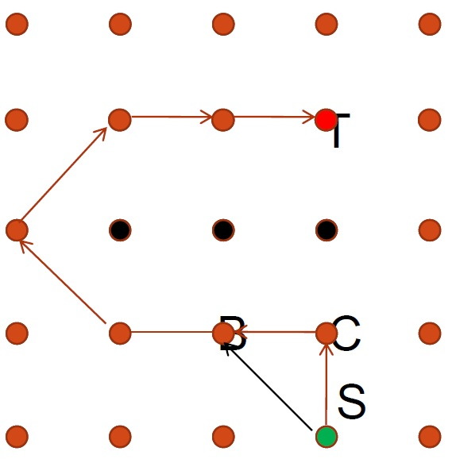
Geographic and Energy Aware Routing
Suppose α = 1
S is sending a packet to T
C is the closer neighbor to T
S Sends the packet through C
S receive new learned cost function from C.
Now, B’s cost function is less than C
Next packet will be sent through B and so on.

Slide 43
Routing Protocols Based on Protocol Operation
Multipath Routing Protocols
Query-Based Routing
Negotiation-Based Routing Protocols

Slide 44
Multipath Routing Protocols
Use multiple paths in order to enhance network performance
Fault tolerance
Balance energy consumption
Energy-efficient
Reliability

Slide 45
Query-Based Routing
Destination nodes propagate a query for data
Usually theses queries are described in natural language or high-level query language
E.g.
Directed diffusion
Rumour routing protocol

Slide 46
Negotiation-Based Routing Protocols
Use high-level data descriptors in order to eliminate redundant data transmissions through negotiation
Communication decisions are also made based on the resources available to them
E.g. SPIN

Slide 47
QoS-based Routing
Has to balance between energy consumption and data quality
E.g. SPEED (congestion avoidance)

Slide 48

THANK YOU

